Slide 1


Science Communications and Science Literacy
Koda Róman Benavidez, Daniel Stolte; University of Arizona Marketing and Communications Office

Slide 2
Objectives over the last several months:
Share compelling stories about research and researchers at the UA
Help make science and related subjects more accessible to non-professionals

Slide 3
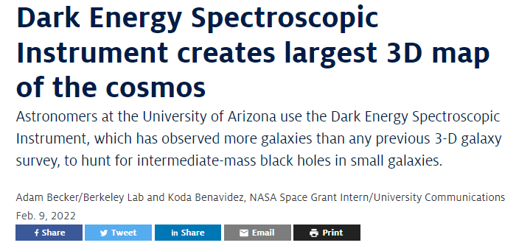
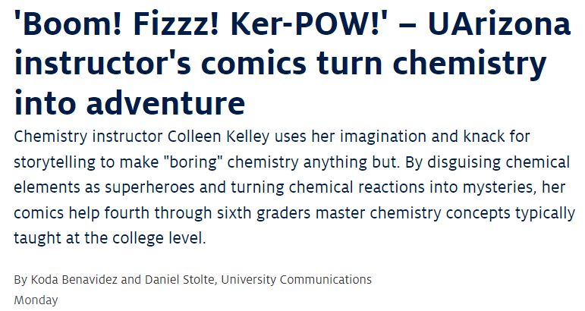

Slide 4
“Why are these topics so important?”

Slide 5
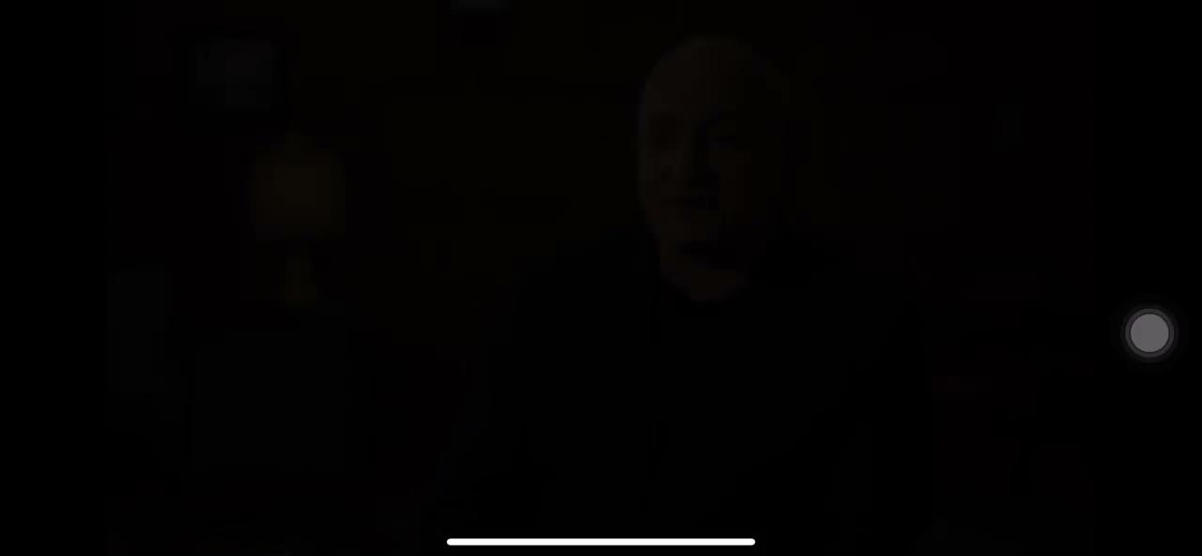
Trailer for the documentary Behind the Curve

Slide 6
“What does this mean for me?”

Slide 7
Thank you!

